Slide 2
How Christmas Should Impact the Way We Live
A Special Message
Selected Scriptures
© December 27, 2015
Wade Harlan
Notes:
2

Slide 3
HOW SHOULD CHRISTMAS IMPACT THE WAY WE LIVE?
Typically we think of Christmas as peaceful and hopeful.
“Silent Night”:
Silent night, holy night
All is calm, all is bright
Round yon Virgin Mother and Child
Holy Infant so tender and mild
Sleep in heavenly peace

Slide 4
HOW SHOULD CHRISTMAS IMPACT THE WAY WE LIVE?
Typically we think of Christmas as peaceful and hopeful.
Luke 2:1-20:
¹ In those days a decree went out from Caesar Augustus that all the world should be registered. ² This was the first registration when Quirinius was governor of Syria. ³ And all went to be registered, each to his own town. ⁴ And Joseph also went up from Galilee, from the town of Nazareth, to Judea, to the city of David, which is called Bethlehem, because he was of the house and lineage of David, ⁵ to be registered with Mary, his betrothed, who was with child. ⁶ And while they were there, the time came for her to give birth. ⁷ And she gave birth to her firstborn son and wrapped him in swaddling cloths and laid him in a manger, because there was no place for them in the inn.

Slide 5
HOW SHOULD CHRISTMAS IMPACT THE WAY WE LIVE?
Typically we think of Christmas as peaceful and hopeful.
Luke 2:1-20:
⁸ And in the same region there were shepherds out in the field, keeping watch over their flock by night. ⁹ And an angel of the Lord appeared to them, and the glory of the Lord shone around them, and they were filled with great fear.¹⁰ And the angel said to them, “Fear not, for behold, I bring you good news of great joy that will be for all the people. ¹¹ For unto you is born this day in the city of David a Savior, who is Christ the Lord.¹² And this will be a sign for you: you will find a baby wrapped in swaddling cloths and lying in a manger.” ¹³ And suddenly there was with the angel a multitude of the heavenly host praising God and saying,
¹⁴ “Glory to God in the highest, and on earth peace among those with whom he is pleased!”

Slide 6
HOW SHOULD CHRISTMAS IMPACT THE WAY WE LIVE?
Typically we think of Christmas as peaceful and hopeful.
Luke 2:1-20:
¹⁵ When the angels went away from them into heaven, the shepherds said to one another, “Let us go over to Bethlehem and see this thing that has happened, which the Lord has made known to us.”¹⁶ And they went with haste and found Mary and Joseph, and the baby lying in a manger. ¹⁷ And when they saw it, they made known the saying that had been told them concerning this child.¹⁸ And all who heard it wondered at what the shepherds told them. ¹⁹ But Mary treasured up all these things, pondering them in her heart. ²⁰ And the shepherds returned, glorifying and praising God for all they had heard and seen, as it had been told them.
Now, let’s listen to a much different biblical account of Christmas.

Slide 7
HOW SHOULD CHRISTMAS IMPACT THE WAY WE LIVE?
Rev 12:1-5
“¹ And a great sign appeared in heaven: a woman
Clothed with the sun, with the moon under her feet, and
on her head a crown of twelve stars. ² She was pregnant and was
crying out in birth pains and the agony of giving birth. ³ And another sign appeared in heaven: behold, a great red dragon, with seven heads and ten horns, and on his heads seven diadems [crowns]. ⁴ His tail swept down a third of the stars of heaven and cast them to the earth. And the dragon stood before the woman who was about to give birth, so that when she bore her child he might devour it. ⁵ She gave birth to a male child, one who is to rule all the nations with a rod of iron, [and]
her child was caught up to God and to his throne.”
— What is the meaning of this passage?

Slide 8
HOW SHOULD CHRISTMAS IMPACT THE WAY WE LIVE?
Psalm 2:7-9:
⁷ “I will tell of the decree:
The LORD said to me, “You are my Son;
today I have begotten you.
⁸ Ask of me, and I will make the nations your heritage,
and the ends of the earth your possession.
⁹ You shall break them with a rod of iron
and dash them in pieces like a potter’s vessel.”
1) Christmas reminds us that we are all involved in a spiritual war.

Slide 9
HOW SHOULD CHRISTMAS IMPACT THE WAY WE LIVE?
2) Christmas reminds we that life is not about acquiring physical wealth, being comfortable or getting things to work smoothly.
Disturbing Aspects of the Christmas account
Lk 1:33 Mary will become pregnant as a virgin.
Lk 1:5-7 Elizabeth, righteous, blameless & barren.
Lk 2:4 Journey to Bethlehem—80 miles!
Lk 2:7 Baby Jesus was placed in a feedthrough.
Lk 2:22-24 They didn’t have enough money for a lamb (Lev. 12:8).
Lk 2:33-35 Mary receives a haunting prophecy from Simeon.
Mt 1:18-19 Mary becomes pregnant/tells Joseph.
Mt 2:1-3 Jerusalem was troubled by talk of a new king.
Mt 2:8-10 Herod’s bold-faced lie and the wise men.
Mt 2:13 Joseph, Mary & Jesus run for their lives.
Mt 2:16 Herod’s troops commit genocide.

Slide 10
HOW SHOULD CHRISTMAS IMPACT THE WAY WE LIVE?
3) Christmas reminds us that Jesus left us his example to follow for how to live life.
John 20:21 Jesus said to them again, “As the Father has sent me, even so I am sending you.” — So, In what manner was Jesus sent?
He willingly gave up his rights and privileges (Phil. 2:5-11).
⁵ Have this mind among yourselves, which is yours in Christ Jesus, ⁶ who, though he was in the form of God, did not count equality with God a thing to be grasped, ⁷ but emptied himself, by taking the form of a servant, being born in the likeness of men. ⁸ And being found in human form, he humbled himself by becoming obedient to the point of death, even death on a cross. ⁹ Therefore God has highly exalted him and bestowed on him the name that is above every name, ¹⁰ so that at the name of Jesus every knee should bow, in heaven and on earth and under the earth, ¹¹ and every tongue confess that Jesus Christ is Lord, to the glory of God the Father.

Slide 11
HOW SHOULD CHRISTMAS IMPACT THE WAY WE LIVE?
3) Christmas reminds we that Jesus left us his example to follow in how to live life.
He was a servant leader (Matt. 20:25-28).
²⁵ But Jesus called them to him and said, “You know that the rulers of the Gentiles lord it over them, and their great ones exercise authority over them. ²⁶ It shall not be so among you. But whoever would be great among you must be your servant, ²⁷ and whoever would be first among you must be your slave, ²⁸ even as the Son of Man came not to be served but to serve, and to give his life as a ransom for many.”
He was never aloof, but fully engaged with people, their cultures and their lives (rubbed life-on-life with people and got his hands dirty down at their level).

Slide 12
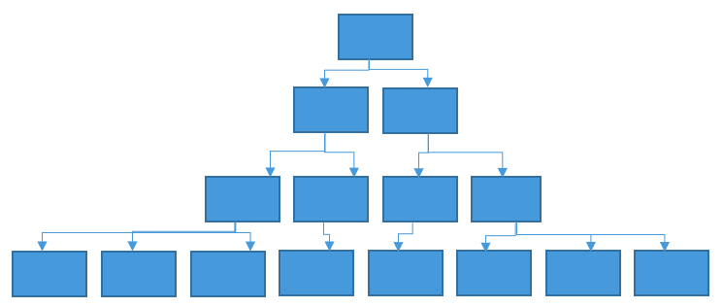
HOW SHOULD CHRISTMAS IMPACT THE WAY WE LIVE?
Contemporary Leadership Model

Slide 13
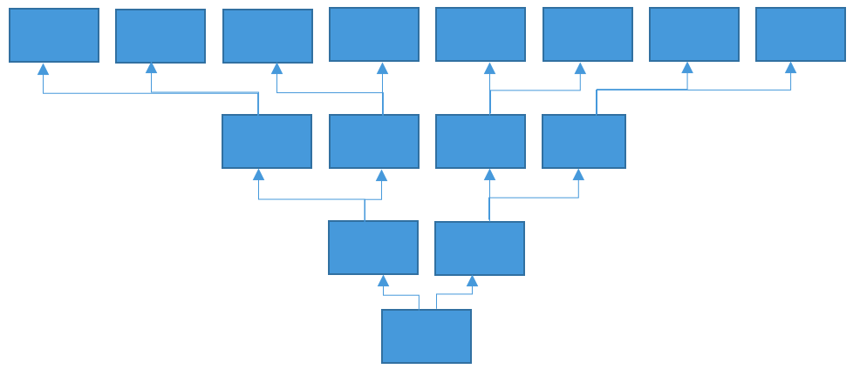
HOW SHOULD CHRISTMAS IMPACT THE WAY WE LIVE?
Jesus’ Leadership Model

Slide 14
The Servant King
By Graham Kendrick [1983]
From heaven You came, helpless babe
Entered our world, Your glory veiled
Not to be served but to serve
And give Your life that we might live
This is our God, the Servant King;
He calls us now to follow Him
To bring our lives as a daily offering
Of worship to the Servant King.
There in the garden of tears
My heavy load He chose to bear;
His heart with sorrow was torn,
Yet not my will, but Yours he said.

Slide 15
The Servant King
By Graham Kendrick [1983]
Come see His hands and his feet
The scars that speak of sacrifice
Hands that flung stars into space
To cruel nails surrendered
So let us learn now to serve,
And in our lives enthrone Him
Each other's needs to prefer
For it is Christ we're serving
This is our God, the Servant King;
He calls us now to follow Him
To bring our lives as a daily offering
Of worship to the Servant King

Slide 16
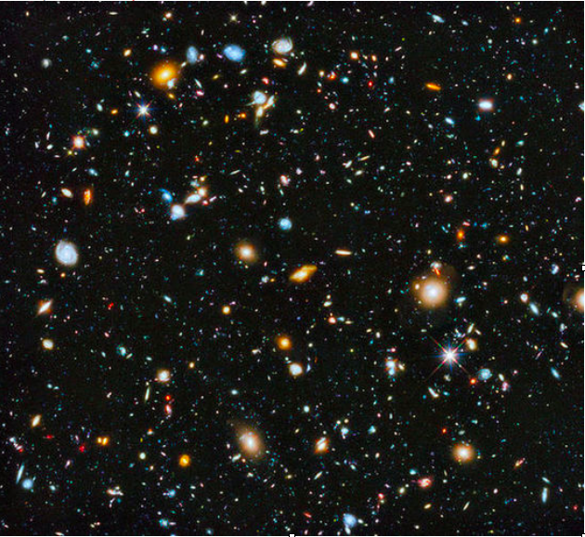
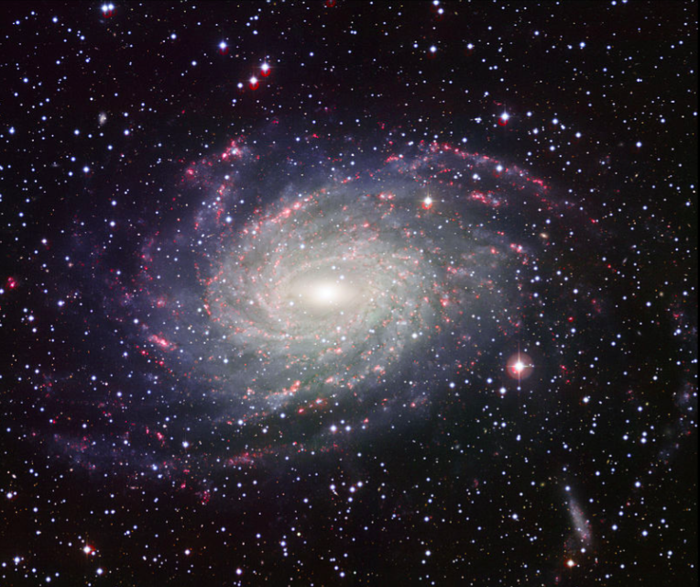
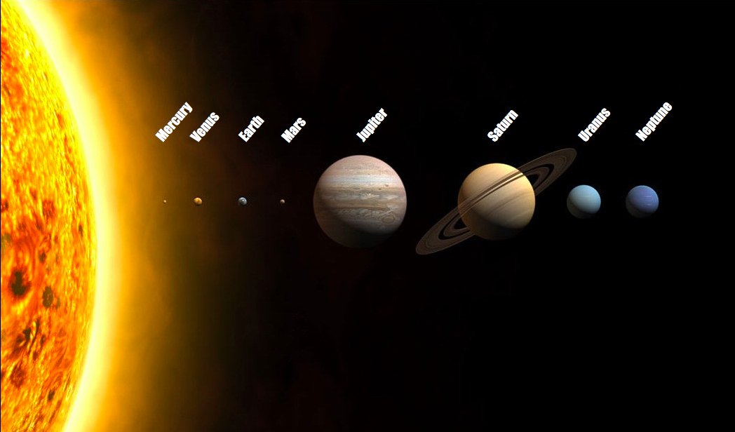

Slide 17
RECAP: CHRISTMAS REMINDS US THAT...
We are all involved in a spiritual war.
Life is NOT primarily about acquiring physical wealth, being comfortable or getting things to work smoothly but about glorifying and enjoying God and loving others.
Jesus left us an example—he expects us to follow in 3 aspects:
He willingly gave up his rights and privileges.
He was a servant leader.
He fully engaged with people, their cultures and their lives (he was never aloof or kept life/people at a distance).

Slide 18
APPLICATION: WHAT DOES IT LOOK LIKE TO FOLLOW JESUS’ EXAMPLE IN THESE DIFFERENT ROLES?
Missionary
Friend
Son/Daughter
Teacher
Pastor
Parent
Soldier
Businessperson
Coach

Slide 19
THREE PRACTICAL QUESTIONS FOR OUR EVERYDAY LIFE
What do you need to do to recognize more that you are daily involved in a spiritual battle?
In what ways have you allowed your life to become focused on wealth, comfort or getting things to work smoothly?
In your life and work, how can you more closely follow Jesus’ example of giving up my rights, being a servant leader and fully engaging with people, their culture, and their lives?

